Slide 1

Web engineering
Adopt an IT skill to change the world

Slide 2
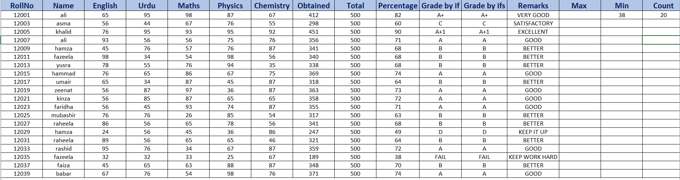
Office automation

Slide 3
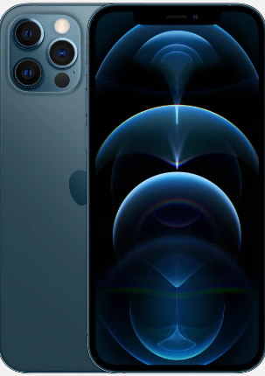
Title
dchdgjk

Slide 4
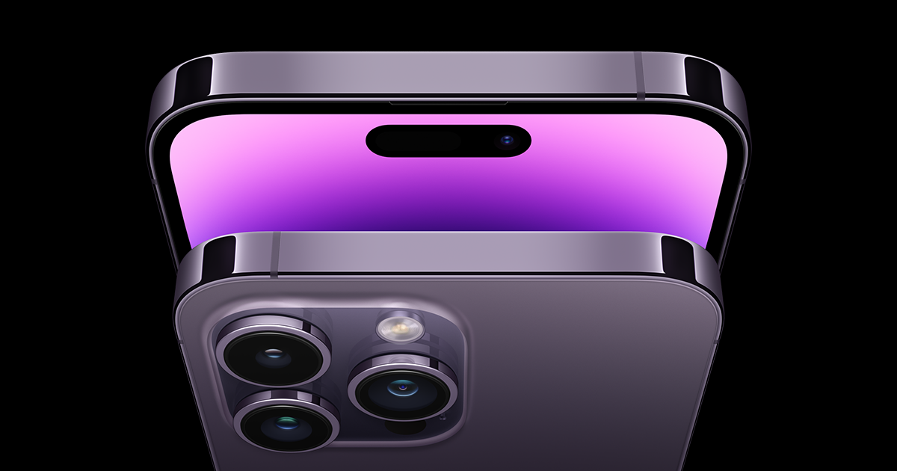
gcfjhasgjh
dcmdvm

